Slide 1

Autonomous Helicopter Navigation System 2010

Slide 2
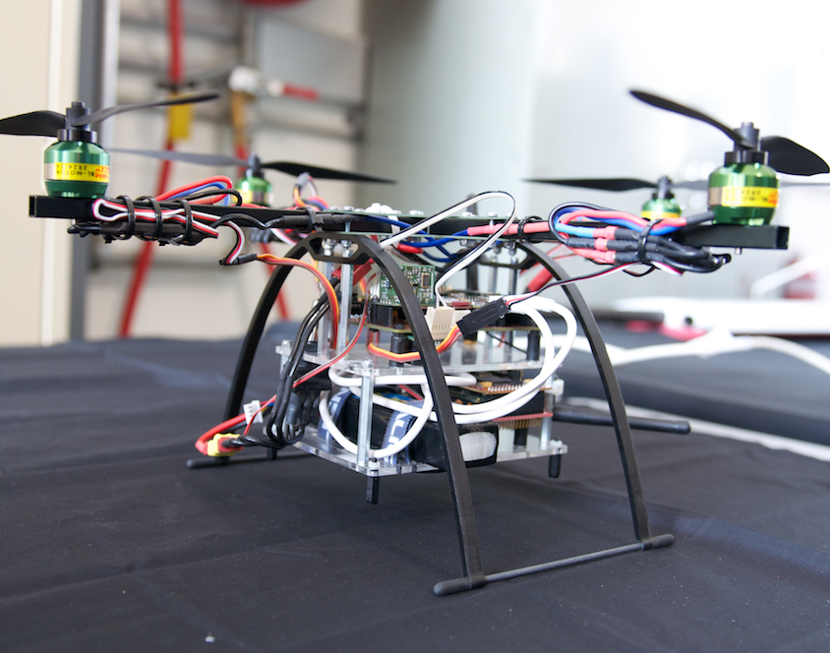
AHNS Project Aim
The Autonomous Helicopter Navigation System 2010 is focused on developing a helicopter system capable of autonomous control, navigation and localising within a GPS denied environment.

Slide 3
Ground Control Station Flight conTrol
Tim Molloy

Slide 4
Ground Control Station
HLO-5 Ground Control Station
SR-B-09 and 08 Receive and Transmit Telemetry via WLAN
SR-D-08 Log Telemetry and Uplink Commands
SR-D-09 Display of State and Control Data
SR-D-10 System Status Display
Received and Transmit Consoles and Data Logger
Data Plotters & Artificial Horizon
System Status Widget
Communications and Vicon Threads; Gains and Parameter Widgets
SR-B-02 Flight Mode Switching
Flight Control Widget

Slide 5
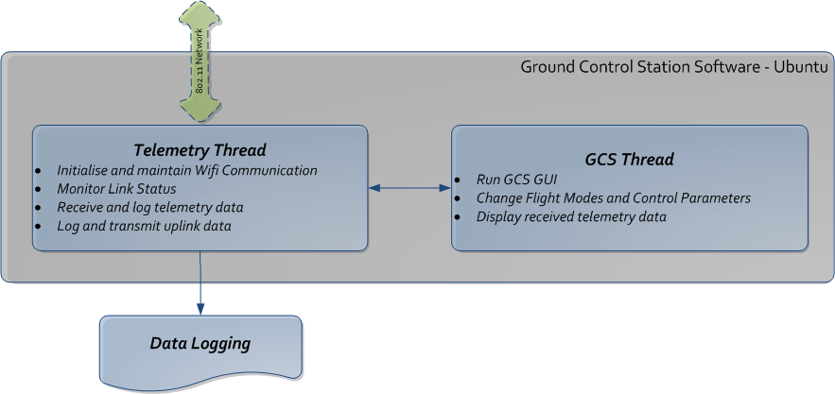
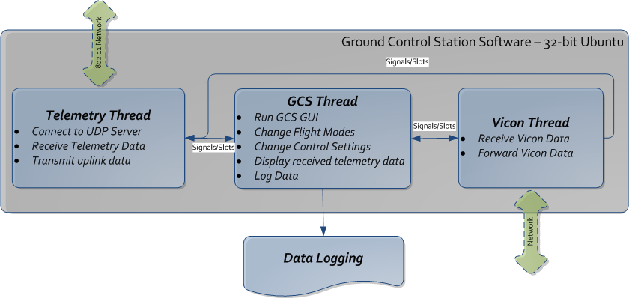
GCS Design (Architecture)

Slide 6
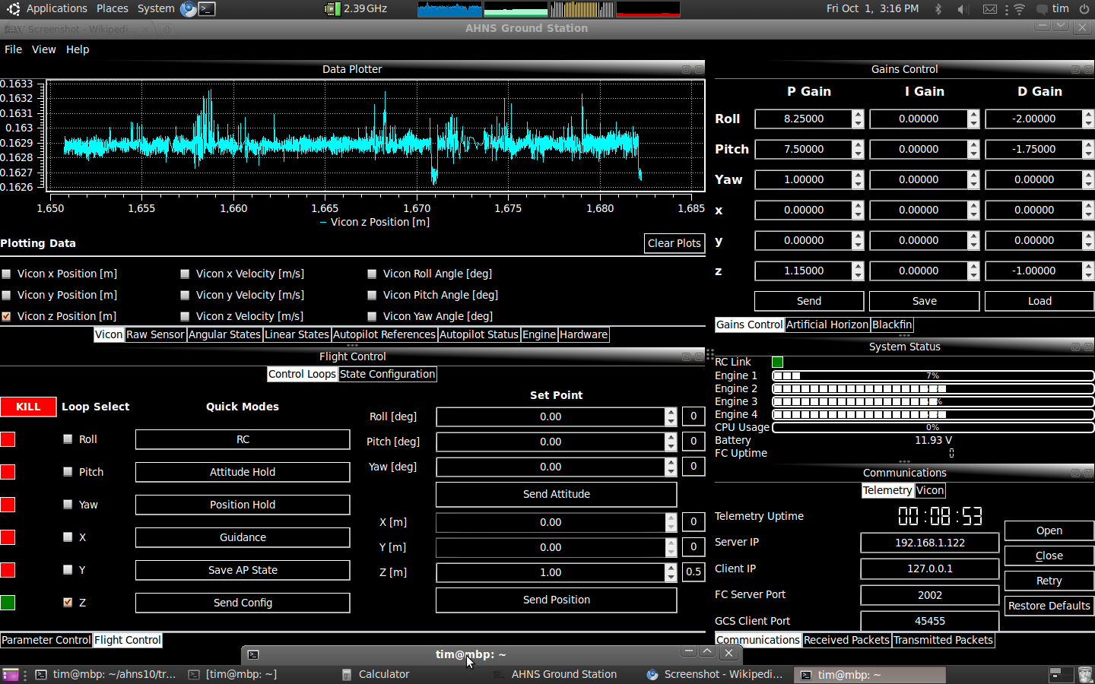
GCS Implementation (User Interface)

Slide 7
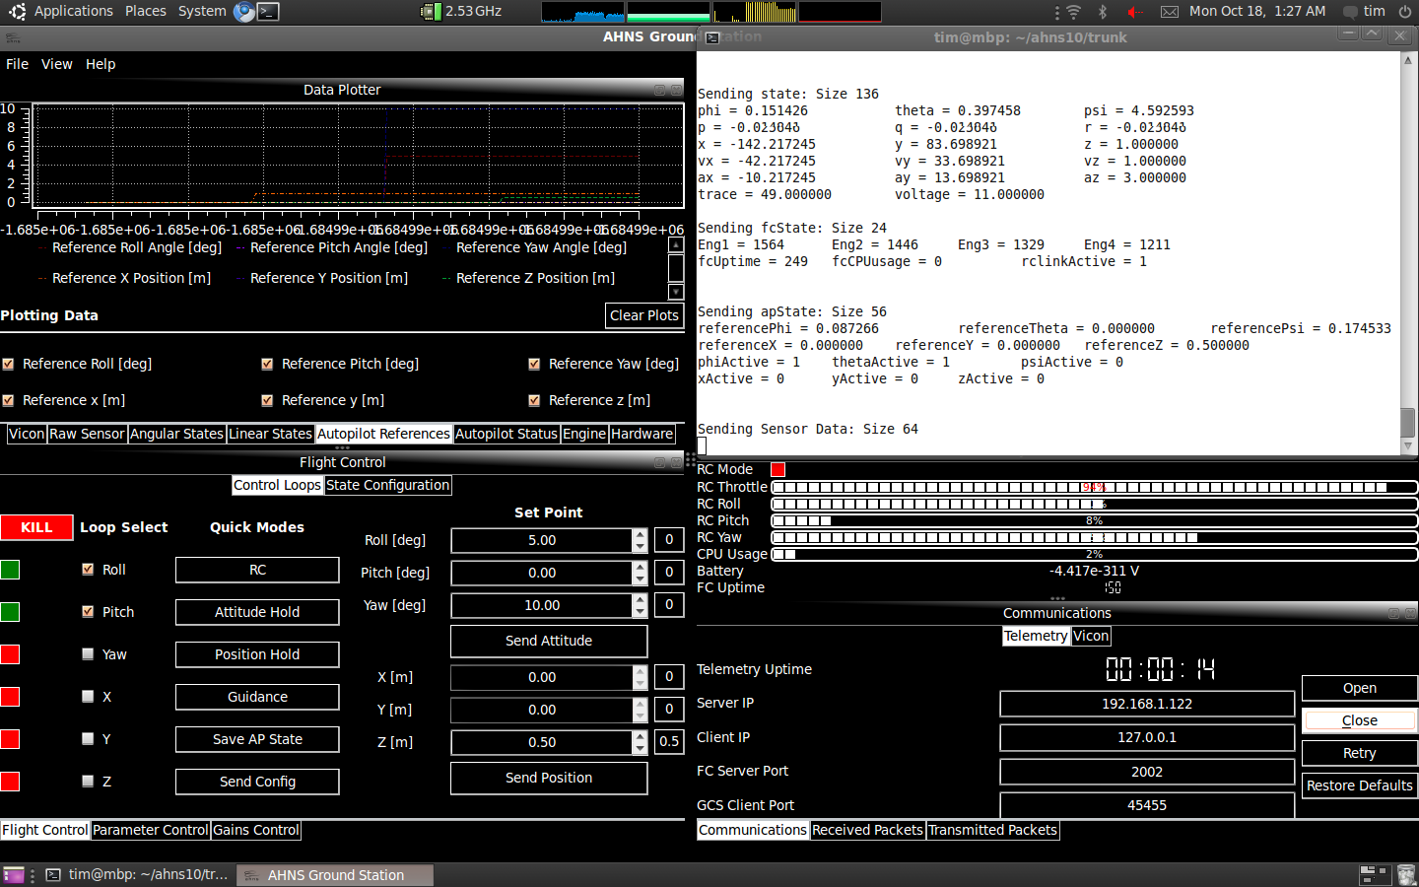
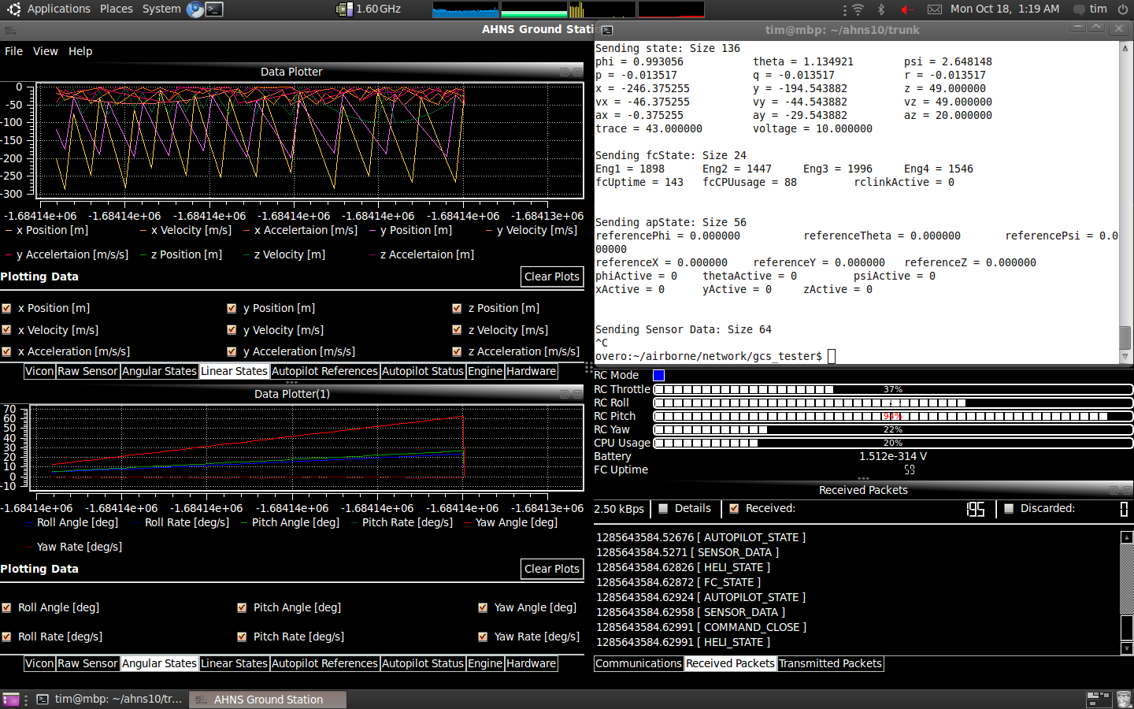
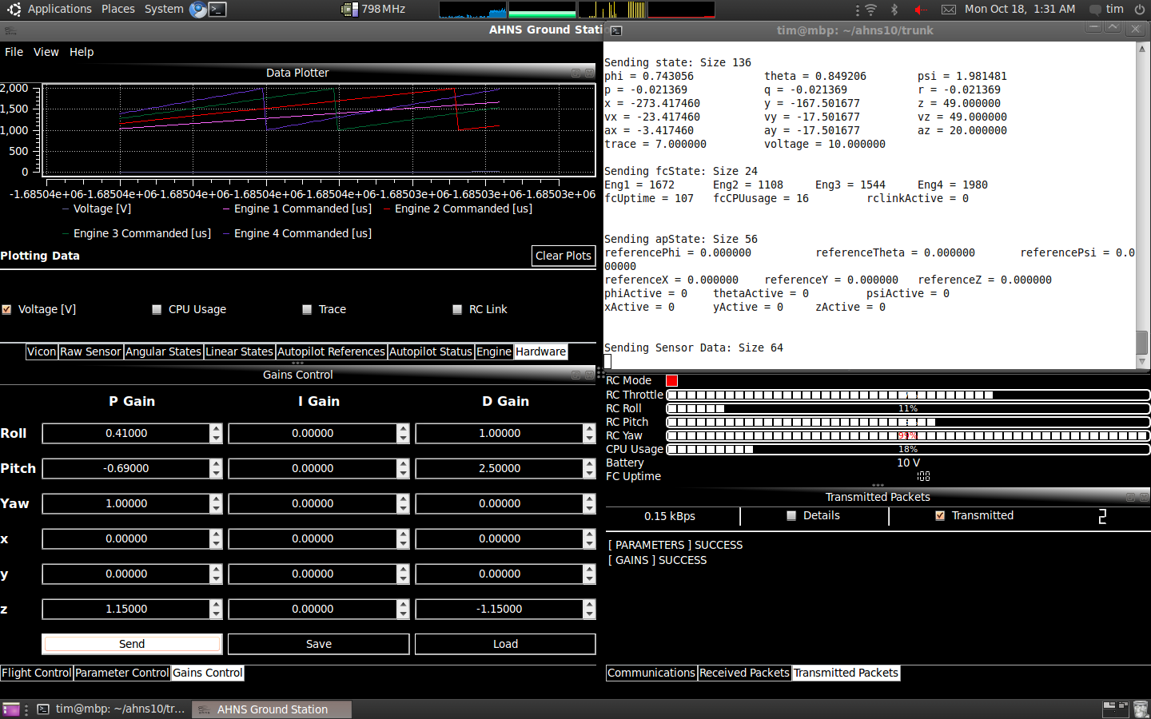
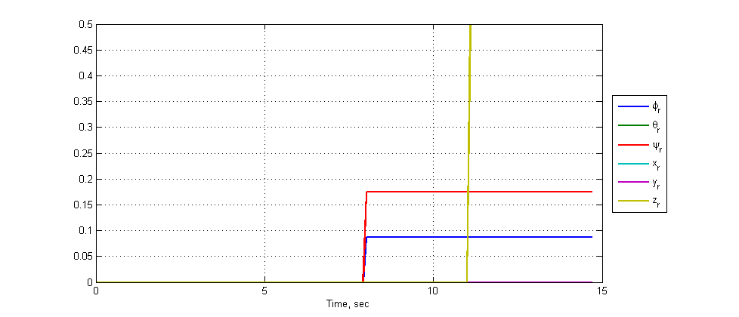
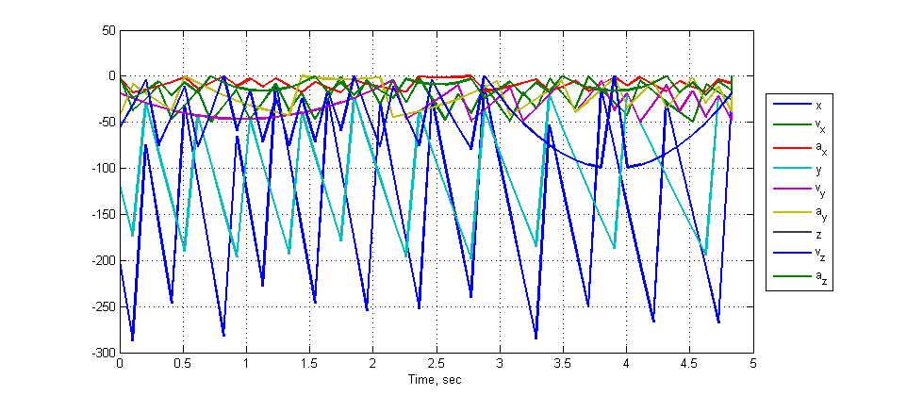
GCS Acceptance Testing
HLO-5 Ground Control Station
SR-B-09 and 08 Receive and Transmit Telemetry via WLAN
SR-D-08 Log Telemetry and Uplink Commands
SR-D-09 Display of State and Control Data
SR-D-10 System Status Display
SR-B-02 Flight Mode Switching
AT-02
AT-08
AT-18
AT-19
AT-20
AT-09
Documented in AHNS-2010-GC-TR-001

Slide 8
Flight Control
HLO-4 Autonomous Hovering Flight
SR-B-03 50Hz Control Rate
SR-B-10 PID Control Methodology
SR-D-03 Stability Augmented Flight
SR-D-04 Autonomous Station-keeping
Flight Computer
Quadrotor Control
Attitude Control
Guidance
Static Angle Setpoints
Dynamic Angle Setpoints
Dynamic Angular Rate Setpoints
Mode Control Unit

Slide 9
Flight Computer and Mode Control Unit

Slide 10
Flight Control Acceptance Testing

Slide 11
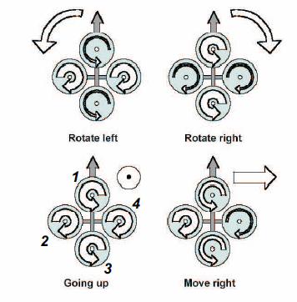
Quadrotor Control
Thrust Altitude Control Forces
Thrust Roll Control Forces
Thrust Pitch Control Forces
Drag Yaw Control Forces

Slide 12
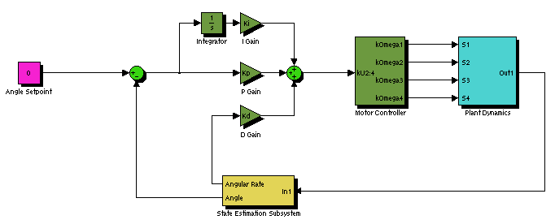
Static Angle Based Attitude Control
Developed in simulator
Implemented and Tested in Test Rig
Did not afford attitude control and removed safety pilot from loop

Slide 13
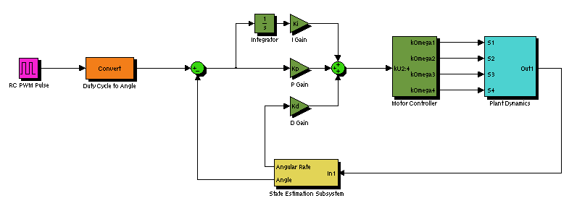
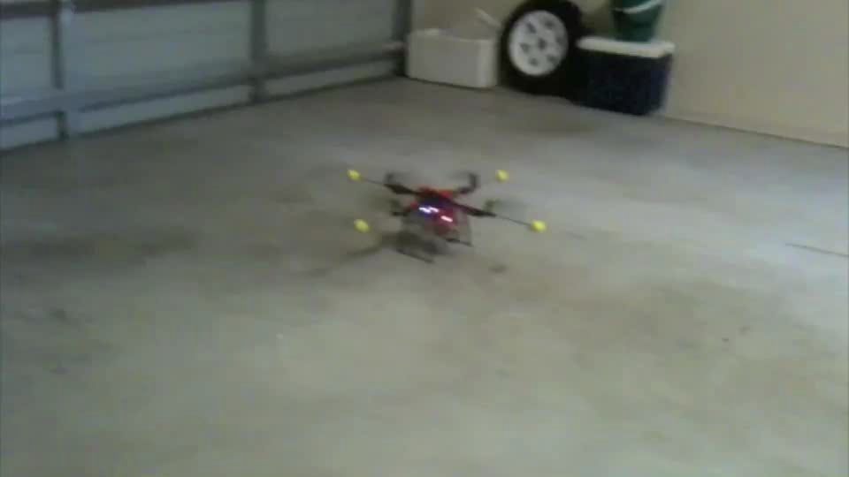
Dynamic Angle Based Attitude Control

Slide 14
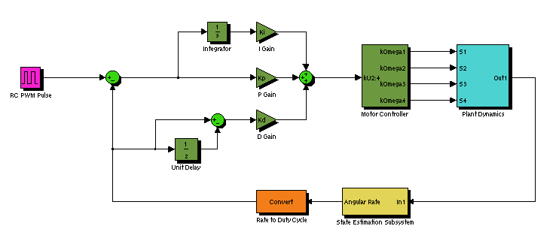
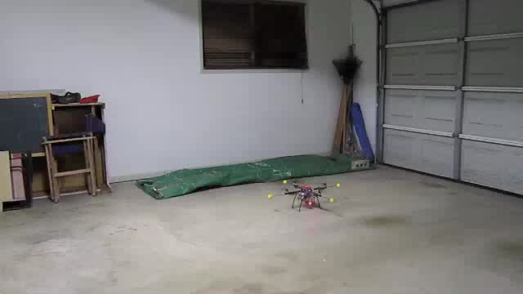
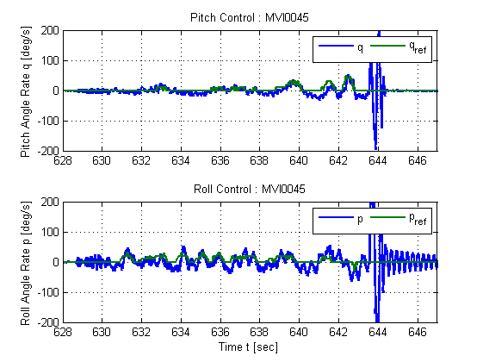
Dynamic Rate Based Attitude Control

Slide 16
Lessons Learnt
First Lesson Learnt
Second Lesson Learnt

Slide 17
System DEMONSTRATION AND QUESTIONS

Slide 18
Michael HAMILTON - 06219314 MICHAEL KINCEL - 06219322 Tim MOLLOY - 06332064 Liam O’Sullivan - 06308627

